Slide 1
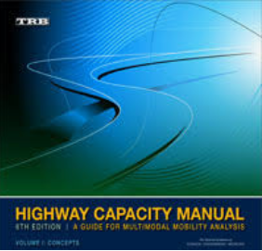
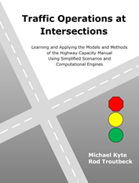




Highway Capacity Manual
6th Edition
Transportation Research Board
Traffic Operations at Intersections
Learning and Applying
the Models and Methods of the
Highway Capacity Manual
Using Simplified Scenarios and
Computational Engines
Michael Kyte and Rod Troutbeck
Notes:
This is a story about two books, the Highway Capacity Manual and our new book, Traffic Operations at Intersections. This presentation is about our new book, Traffic Operations at Intersections connects to the chapter of the Highway Capacity Manual that deal with signalized intersections. My name is Michael Kyte. Rod Troutbeck and I have written our book to provide a way to learn about the models and methods of the HCM by starting simply, using what we call simplified scenarios. Each of the seven simplified scenarios presented in chapter 4, the chapter of our book on signalized intersections, presents one aspect of the HCM signalized intersection model but with very simplified geometric or control conditions. This presentation will provide you with an overview of the HCM method, give you an introduction to our book, show you how the topics presented in our book connect with the signalized intersection method of the HCM.
OR:
When the HCM was first published in 1950, the method for analyzing signalized intersections was covered in xx pages. [List sections of the chapter]
[See my TRB paper on signalized intersections, a state of crisis]
[cover HCM method first, then come back to book?]

Slide 2
Concepts
Phase duration
Data
Capacity
v/c ratio
Analysis Units
Delay
Flow rates
Level of service
Saturation flow rate
Queue storage ratio
Arrival pattern
Interpretation
HCM Signalized Intersection Methodology
Notes:
The HCM method has twelve steps, shown in blue on the left part of the slide. These twelve steps can be grouped into three parts:
Preparation,
Analysis, and
Predicted results.

Slide 3
Concepts
Phase duration
Preparation
What are the concepts that you must understand to be able to apply the HCM method and interpret the results that it produces?
What are the data that you need to apply the HCM methode?
Data
Capacity
v/c ratio
Analysis Units
Delay
Flow rates
Level of service
Saturation flow rate
Queue storage ratio
Arrival pattern
Interpretation
HCM Signalized Intersection Methodology
Notes:
We can translate each of the twelve steps into a set of twelve questions. Let’s go through each of the three parts and list these questions.
First, your preparation for the HCM method includes learning about concepts and the data required to use the HCM method.

Slide 4
Concepts
Phase duration
Analysis
What are the analysis units to which you will apply the HCM method?
What is the demand flow rate for each analysis unit?
What is the saturation flow rate for each analysis unit?
What is the arrival pattern for each analysis unit?
What is the duration of each signal phase?
Data
Capacity
v/c ratio
Analysis Units
Delay
Flow rates
Level of service
Saturation flow rate
Queue storage ratio
Arrival pattern
Interpretation
HCM Signalized Intersection Methodology
Notes:
The second part, Analysis, asks five questions that relate to:
Analysis units
Flow rates
Saturation flow rate
Arrival pattern

Slide 5
Concepts
Phase duration
Predicted results
What are the predicted capacity and volume-to-capacity ratio for each analysis unit?
What is the predicted delay for each analysis unit?
What is the level of service for each analysis unit?
What is the predicted queue service ratio for each analysis unit?
What can you learn from the predicted results?
Data
Capacity
v/c ratio
Analysis Units
Delay
Flow rates
Level of service
Saturation flow rate
Queue storage ratio
Arrival pattern
Interpretation
HCM Signalized Intersection Methodology
Notes:
The third part, Predicted Results, includes five questions that deal with:
Capacity and v/c ratio
Delay
Level of service
Queue storage ratio
Interpretation

Slide 6
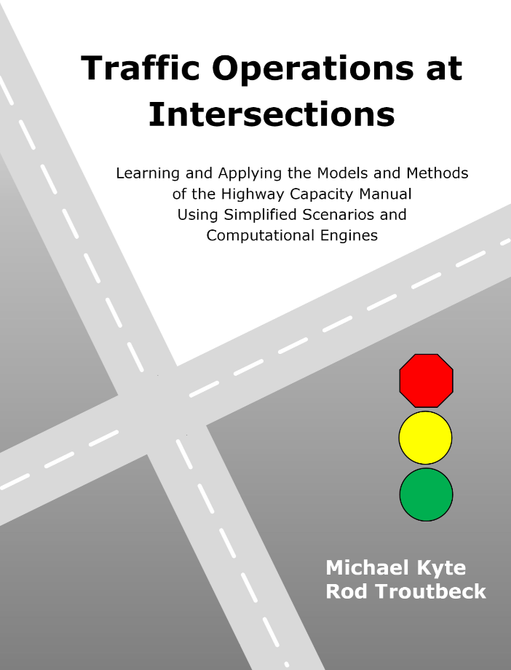
Concepts
Phase duration
Concepts
4.3 Movements and Phases
Capacity
4.9 Critical movement analysis
Data
Capacity
v/c ratio
Concepts
4.4 Timing Processes
Delay
4.10 Demand > capacity
Analysis Units
Delay
Concepts
4.5 Formulating the Model
Delay
4.11 Non-uniform arrivals
Flow rates
Level of service
Capacity
4.6 Lane capacity
Phase duration
4.12 Phase duration
Saturation flow rate
Queue storage ratio
Delay
4.7 Demand < capacity
Arrival pattern
Interpretation
Capacity
4.8 Permitted LT movement
HCM Signalized Intersection Methodology
Chapter 4 – Capacity of Signalized Intersections
Notes:
As you proceed, you will see that the twelve steps of the HCM method relate to the sections of Chapter 4 of our book. To help you follow, the HCM method is shown in blue, while the sections of our book are shown in gray. Not of the twelve HCM steps are covered in our book, but much of the guts of the method are included.
You will see how each the sections of Chapter 4 of our book is linked to the relevant parts of the four chapters of the HCM that deal with signalized intersections.

Slide 7
Concepts
Phase duration
Concepts
4.3 Movements and Phases
Capacity
4.9 Critical movement analysis
Data
Capacity
v/c ratio
Concepts
4.4 Timing Processes
Delay
4.10 Demand > capacity
Analysis Units
Delay
Concepts
4.5 Formulating the Model
Delay
4.11 Non-uniform arrivals
Flow rates
Level of service
Capacity
4.6 Lane capacity
Phase duration
4.12 Phase duration
Saturation flow rate
Queue storage ratio
Delay
4.7 Demand < capacity
Arrival pattern
Interpretation
Capacity
4.8 Permitted LT movement
HCM Signalized Intersection Methodology
Chapter 4 – Capacity of Signalized Intersections
Notes:
These next few slides show which sections of the HCM method link to which sections in our book. This slide shows that we cover three concepts in our book including:
Movements and phases
Timing processes
Formulating the model (which addresses the basic queuing model on which the HCM method is based)

Slide 8
Concepts
Phase duration
Concepts
4.3 Movements and Phases
Capacity
4.9 Critical movement analysis
Data
Capacity
v/c ratio
Concepts
4.4 Timing Processes
Delay
4.10 Demand > capacity
Analysis Units
Delay
Concepts
4.5 Formulating the Model
Delay
4.11 Non-uniform arrivals
Flow rates
Level of service
Capacity
4.6 Lane capacity
Phase duration
4.12 Phase duration
Saturation flow rate
Queue storage ratio
Delay
4.7 Demand < capacity
Arrival pattern
Interpretation
Capacity
4.8 Permitted LT movement
HCM Signalized Intersection Methodology
Chapter 4 – Capacity of Signalized Intersections
Notes:
The sixth step in the HCM method deals with arrival patterns of traffic at a signalized intersection. We cover the model that addresses non-uniform arrivals, and its effect on delay, in Section 4.11 of our book.

Slide 9
Concepts
Phase duration
Concepts
4.3 Movements and Phases
Capacity
4.9 Critical movement analysis
Data
Capacity
v/c ratio
Concepts
4.4 Timing Processes
Delay
4.10 Demand > capacity
Analysis Units
Delay
Concepts
4.5 Formulating the Model
Delay
4.11 Non-uniform arrivals
Flow rates
Level of service
Capacity
4.6 Lane capacity
Phase duration
4.12 Phase duration
Saturation flow rate
Queue storage ratio
Delay
4.7 Demand < capacity
Arrival pattern
Interpretation
Capacity
4.8 Permitted LT movement
HCM Signalized Intersection Methodology
Chapter 4 – Capacity of Signalized Intersections
Notes:
The seventh step of the HCM method deals with phase duration, both for pretimed and actuated traffic signals. We cover the model that predicts phase duration for actuated control in Section 4.12 in our book.

Slide 10
Concepts
Phase duration
Concepts
4.3 Movements and Phases
Capacity
4.9 Critical movement analysis
Data
Capacity
v/c ratio
Concepts
4.4 Timing Processes
Delay
4.10 Demand > capacity
Analysis Units
Delay
Concepts
4.5 Formulating the Model
Delay
4.11 Non-uniform arrivals
Flow rates
Level of service
Capacity
4.6 Lane capacity
Phase duration
4.12 Phase duration
Saturation flow rate
Queue storage ratio
Delay
4.7 Demand < capacity
Arrival pattern
Interpretation
Capacity
4.8 Permitted LT movement
HCM Signalized Intersection Methodology
Chapter 4 – Capacity of Signalized Intersections
Notes:
The eighth step of the HCM method deals with its fundamental prediction, capacity. Since the first edition of the HCM in 1950, capacity is the product of the proportion of the cycle that is green and the saturation flow rate. We cover various parts of the capacity model in Section 4.6 (lane capacity), Section 4.8 (permitted left turn), and Section 4.9 (critical movement analysis) in our book.

Slide 11
Concepts
Phase duration
Concepts
4.3 Movements and Phases
Capacity
4.9 Critical movement analysis
Data
Capacity
v/c ratio
Concepts
4.4 Timing Processes
Delay
4.10 Demand > capacity
Analysis Units
Delay
Concepts
4.5 Formulating the Model
Delay
4.11 Non-uniform arrivals
Flow rates
Level of service
Capacity
4.6 Lane capacity
Phase duration
4.12 Phase duration
Saturation flow rate
Queue storage ratio
Delay
4.7 Demand < capacity
Arrival pattern
Interpretation
Capacity
4.8 Permitted LT movement
HCM Signalized Intersection Methodology
Chapter 4 – Capacity of Signalized Intersections
Notes:
The HCM method has twelve steps, shown in blue on the left part of the slide. The seven simplified scenarios and introductory concepts from our book are shown in gray on the right part of the slide. We will see how each the sections of Chapter 4 of our book is linked to the relevant parts of the four chapters of the HCM that deal with signalized intersections.
The nineth step of the HCM method deals with the prediction of delay. We cover the prediction of delay when demand is less than capacity in Section 4.7 and when demand is greater than capacity in Section 4.8. Section 4.11 covers the prediction of delay when the arrival pattern is non-uniform.

Slide 12
Concepts
Phase duration
Traffic flow characteristics
Intersection traffic movements
Traffic flow characteristics
HCM reference
pp. 19-5 to 19-6
pp. 19-9 to 19-12
Data
Capacity
v/c ratio
Traffic signal basics
Types of traffic signal control
Signal phase sequence
Operational modes
Left-turn phase sequence
Phase duration
HCM reference
pp. 19-4 to 19-5
pp. 19-6 to 19-7
pp. 19-7 to 19-8
pp. 19-8 to 19-9
pp. 19-12 to 19-14
Analysis Units
Delay
Flow rates
Level of service
Saturation flow rate
Queue storage ratio
Arrival pattern
Interpretation
HCM Signalized Intersection Methodology
Notes:
Let’s now go through each of these twelve steps from the HCM. The first step addresses concepts, and there are two kinds of concepts, traffic flow characteristics and traffic signal basics. The references to the HCM are shown here on the right part of the slide. For example, intersection traffic movements are discussed in pages 19-5 to 19-6 of the HCM, while phase duration is discussed on pages 19-12 through 19-14.

Slide 13
Concepts
3. Movements and Phases
Signal timing concepts
Concurrency group
Phase
Ring barrier diagram
Timers
Traffic control process diagram
Effective and displayed times
Phase duration
Chapter 4 – Capacity of Signalized Intersections
Notes:
Many of these same concepts are covered in three sections of Chapter 4 of our book. Movements and phases are covered in Section 3. Here we see one of those concepts illustrated, the concept of concurrency group.

Slide 14
Concepts
3. Movements and Phases
Signal timing concepts
Concurrency group
Phase
Ring barrier diagram
Timers
Traffic control process diagram
Effective and displayed times
Phase duration
Chapter 4 – Capacity of Signalized Intersections
Notes:
The phase is a fundamental concept covered in Section 3 of our book. The phase is a timing unit (the consecutive displays of green, yellow, and red) that controls one or more traffic movements. The ring barrier diagram shows which phases can time concurrently (at the same time) and those that must time (for safety reasons) consecutively.

Slide 15
Concepts
4. Timing Processes
Signal timing concepts
Concurrency group
Phase
Ring barrier diagram
Timers
Traffic control process diagram
Effective and displayed times
Phase duration
Chapter 4 – Capacity of Signalized Intersections
Notes:
Most traffic controls are actuated. Three timers determine how a phase times: the minimum green timer, the passage timer, and the maximum green timer.

Slide 16
Concepts
4. Timing Processes
Signal timing concepts
Concurrency group
Phase
Ring barrier diagram
Timers
Traffic control process diagram
Effective and displayed times
Phase duration
Chapter 4 – Capacity of Signalized Intersections
Notes:
The traffic control process diagram shows how the components of the control system interrelate. The diagram shows how the user, the detector, the controller, and the display relate together.

Slide 17
Concepts
4. Timing Processes
Signal timing concepts
Concurrency group
Phase
Ring barrier diagram
Timers
Traffic control process diagram
Effective and displayed times
Phase duration
Chapter 4 – Capacity of Signalized Intersections
Notes:
Finally, we show the relationship between the displayed green and red times that users see and the effective green and red times that show user behavior.

Slide 18
Concepts
5. Formulating the Model
Traffic flow concepts
Flow profile diagram
Cumulative vehicle diagram
Queue accumulation polygon
Chapter 4 – Capacity of Signalized Intersections
Notes:
In addition to the signal control basics, we cover the fundamentals of traffic flow. We do this visually, using three diagrams. The first is the flow profile diagram, which shows the flow rates for both vehicles arriving at the intersection and departing from the intersection.

Slide 19
Concepts
5. Formulating the Model
Traffic flow concepts
Flow profile diagram
Cumulative vehicle diagram
Queue accumulation polygon
Chapter 4 – Capacity of Signalized Intersections
Notes:
The second is the cumulative vehicle diagram, the cumulative number of vehicles arriving at and departing from the intersection over time.

Slide 20
Concepts
5. Formulating the Model
Traffic flow concepts
Flow profile diagram
Cumulative vehicle diagram
Queue accumulation polygon
Chapter 4 – Capacity of Signalized Intersections
Notes:
The third diagram is the queue accumulation polygon, a plot of the queue size over time. The queue size is the difference between the number of vehicles that have arrived and departed over time.

Slide 21
Concepts
Phase duration
Traffic characteristics data
Demand flow rate
Right-turn-on-red flow rate
Percentage heavy vehicles
Intersection peak hour factor
Platoon ratio
Determining platoon ratio
Guidance for estimating platoon ratio
Upstream filtering adjustment factor
Initial queue
Base saturation flow rate
Lane utilization adjustment factor
On-street parking maneuver rate
Unsignalized movement delay
HCM reference
pp. 19-22 to 19-32
Data
Capacity
v/c ratio
Analysis Units
Delay
Flow rates
Level of service
Saturation flow rate
Queue storage ratio
Arrival pattern
Interpretation
HCM Signalized Intersection Methodology
Notes:
The second step in the HCM method is data: what data are needed in order to conduct an analysis using the HCM signalized intersection method. There are four categories of data. The first is traffic characteristics.

Slide 22
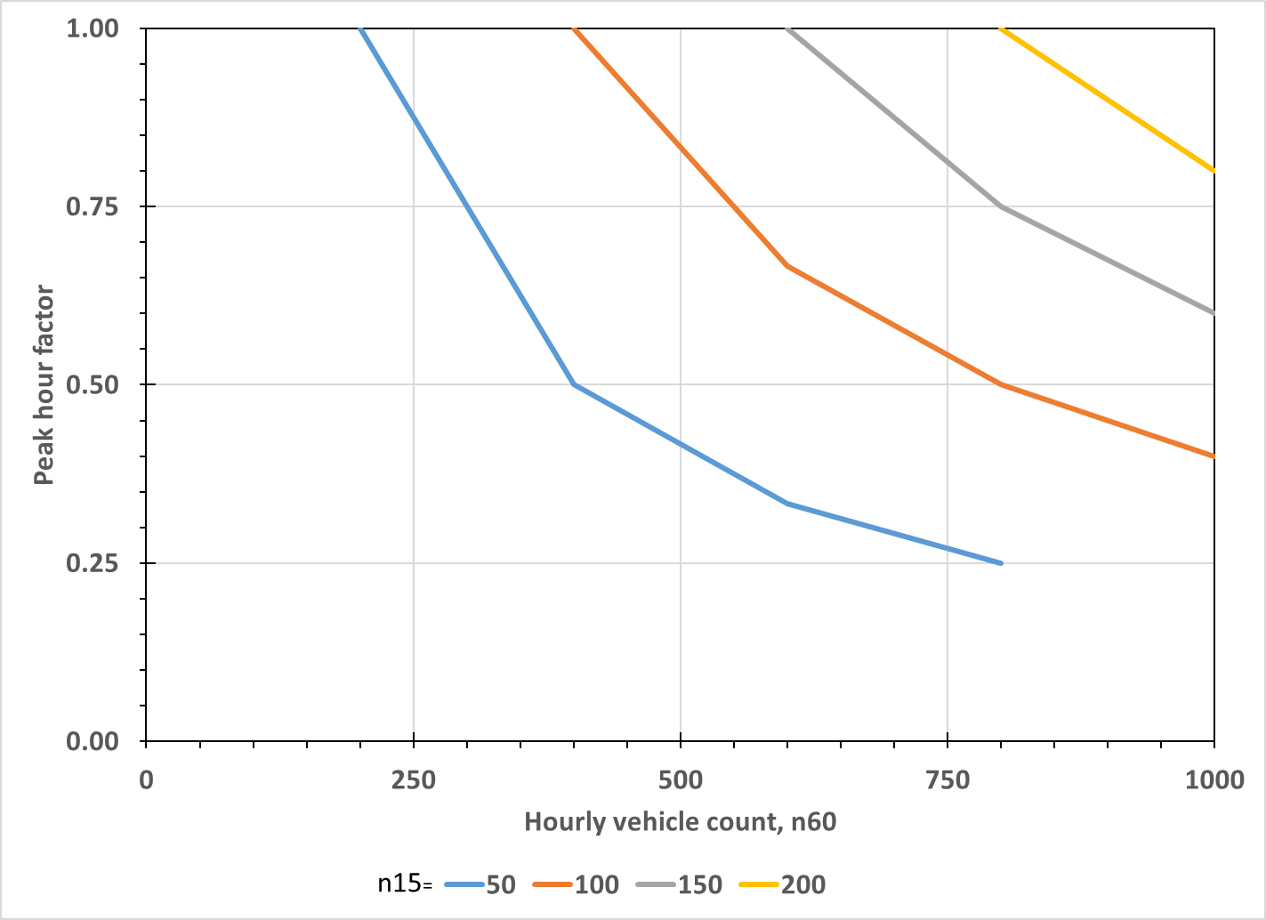
Concepts
Phase duration
Traffic characteristics data
Demand flow rate
Right-turn-on-red flow rate
Percentage heavy vehicles
Intersection peak hour factor
Platoon ratio
Determining platoon ratio
Guidance for estimating platoon ratio
Upstream filtering adjustment factor
Initial queue
Base saturation flow rate
Lane utilization adjustment factor
On-street parking maneuver rate
Unsignalized movement delay
HCM reference
pp. 19-22 to 19-32
Data
Capacity
v/c ratio
Analysis Units
Delay
PHF=0.86
Flow rates
Level of service
Saturation flow rate
Queue storage ratio
Arrival pattern
Interpretation
HCM Signalized Intersection Methodology
Notes:
One example of traffic characteristics is the intersection peak hour factor. The peak hour factor shows the level of peaking of traffic in any one fifteen minute during the hour. Here we see an example when the 60 minute count is 700 vehicles and the 15 minute count is 150 vehicles. The resulting peak hour factor is 0.86.

Slide 23
Concepts
Phase duration
Geometric design data
Number of lanes
Average lane width
Number of receiving lanes
Turn bay length
Presence of on-street parking
Approach grade
HCM reference
pp. 19-33 to 19-34
Data
Capacity
v/c ratio
Analysis Units
Delay
Flow rates
Level of service
Saturation flow rate
Queue storage ratio
Arrival pattern
Interpretation
HCM Signalized Intersection Methodology
Notes:
The second is geometric design data, including the number of lanes and the width of the lanes.

Slide 24
Concepts
Phase duration
Signal control data
Type of signal control
Phase sequence
Left-turn operational mode
Dallas left-turn phasing option
Actuated control
  Passage time
  Maximum green
  Minimum green
  Phase recall
  Dual entry
  Simultaneous gap-out
Coordinated-actuated control
  Cycle length
  Phase splits
  Offset and offset reference point
  Force mode
Pretimed control
  Green duration
  Cycle length
Yellow change and red clearance
Walk
Pedestrian clear
HCM reference
pp. 19-34 to 19-39
Data
Capacity
v/c ratio
Analysis Units
Delay
Flow rates
Level of service
Saturation flow rate
Queue storage ratio
Arrival pattern
Interpretation
HCM Signalized Intersection Methodology
Notes:
The third is the signal control data, with some differences whether the signal control system is pretimed or actuated.

Slide 25
Concepts
Phase duration
Other data
Analysis period duration
Speed limit
Actuated control
  Stop-line detector length
  Detection mode
Area type
HCM reference
pp. 19-39 to 19-40
Data
Capacity
v/c ratio
Analysis Units
Delay
Flow rates
Level of service
Saturation flow rate
Queue storage ratio
Arrival pattern
Interpretation
HCM Signalized Intersection Methodology
Notes:
The fourth category includes other miscellaneous, but important, information about the intersection to be studied.

Slide 26
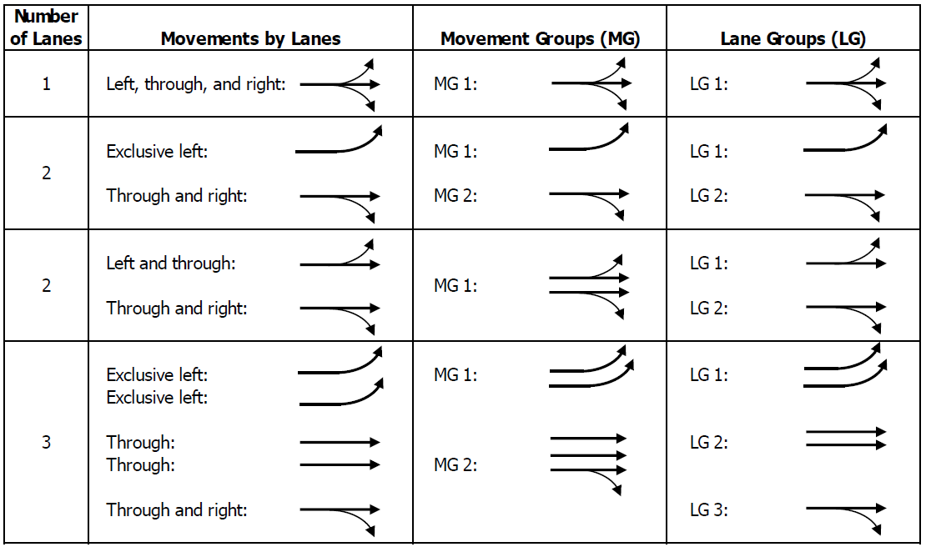
Concepts
Phase duration
Movement groups
Lane groups
HCM reference
pp. 19-42 to 19-43
Data
Capacity
v/c ratio
Analysis Units
Delay
Flow rates
Level of service
Saturation flow rate
Queue storage ratio
Arrival pattern
Interpretation
HCM Signalized Intersection Methodology
Notes:
The third step in the HCM method is the definition of the units to which the analysis will be applied. This analysis unit is either the movement group or lane group. A lane group is xxx.

Slide 27
Concepts
Phase duration
Movement group flow rate
Lane group flow rate
Lane group flow rates on multiple-lane approaches
HCM reference
p. 19-44
pp. 31-22 to 31-29
Data
Capacity
v/c ratio
Analysis Units
Delay
Flow rates
Level of service
Saturation flow rate
Queue storage ratio
Arrival pattern
Interpretation
HCM Signalized Intersection Methodology
Notes:
The flow rate for each lane group is determined in the fourth step of the HCM method.

Slide 28
Concepts
Phase duration
Adjustments
Lane width
Heavy vehicles and grade
Parking lane and parking activity
Bus blockage
Area type
Lane utilization
Left-turn vehicles
Right-turn vehicles
Work zone presence
Downstream lane blockage
Sustained spillback
HCM reference
pp. 19-34 to 19-49
Data
Capacity
v/c ratio
Analysis Units
Delay
Flow rates
Level of service
Lane width adjustment factor
Average lane width (ft) | Adjustment factor f_{w} | Saturation flow rate (veh/hr)
<10.0 | 0.96 | 1824
≥10.0 – 12.9 | 1.00 | 1900
>12.9 | 1.04 | 1976
Saturation flow rate
Queue storage ratio
Arrival pattern
Interpretation
HCM Signalized Intersection Methodology
Notes:
The saturation flow rate for each lane group is determined in step 5. The base saturation flow rate is 1900 vehicles per hour. Adjustments to this base rate are applied based on lane width, the proportion of heavy vehicles in the traffic stream and grade, and left turn movements, among others. For example , the saturation flow rate for a nine foot lane is four percent less than this base value, or 1824 vehicles per hour.

Slide 29
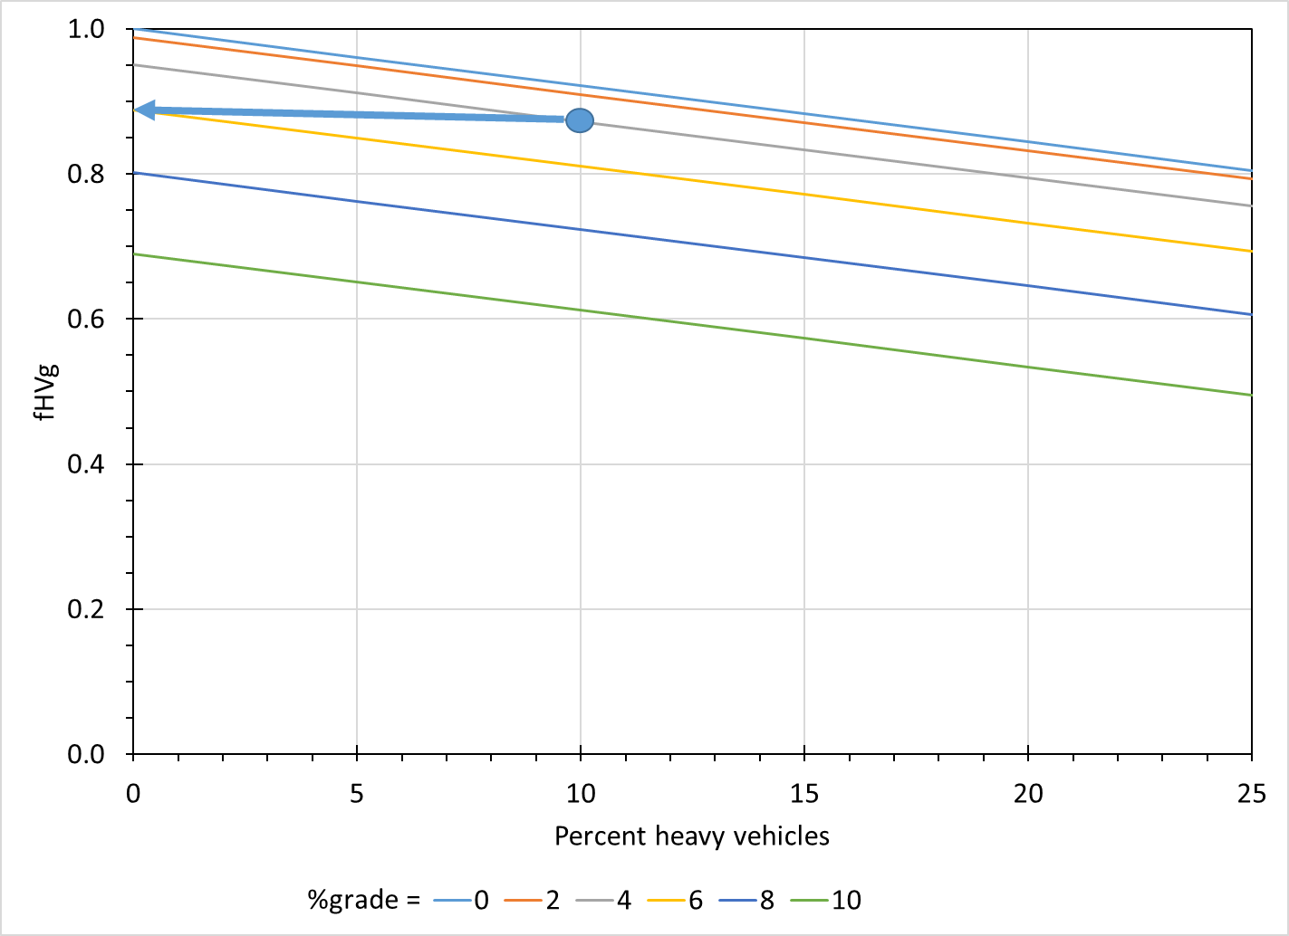
Concepts
Phase duration
Adjustments
Lane width
Heavy vehicles and grade
Parking lane and parking activity
Bus blockage
Area type
Lane utilization
Left-turn vehicles
Right-turn vehicles
Work zone presence
Downstream lane blockage
Sustained spillback
HCM reference
pp. 19-34 to 19-49
Data
Capacity
v/c ratio
Analysis Units
Delay
Flow rates
Level of service
**Check out or range issue
Saturation flow rate
Queue storage ratio
Arrival pattern
Interpretation
HCM Signalized Intersection Methodology
Notes:
Another adjustment to the base saturation flow rate comes from the proportion of heavy vehicles and the approach grade. In this example, we see that if the traffic stream has 10 percent trucks traveling on a ten percent approach grade, the base saturation flow rate would be reduced by nearly 23 percent, declining from 1900 to 1656 vehicles per hour.

Slide 30
Saturation flow rate
13. Saturation headway
Objective
Measure saturation headway
Concepts
Start-up lost time
Chapter 4 – Capacity of Signalized Intersections
Notes:
While we don’t cover these adjustment factors in our book, we do show you how to measure the saturation headway in the field, and then to directly calculate the saturation flow rate for a particular site. One of the most important parts of this measurement is the determination of the start-up lost time, the additional time in the headways in the first four vehicles of the traffic stream that result from their acceleration from a stop to their normal travel speed.

Slide 31
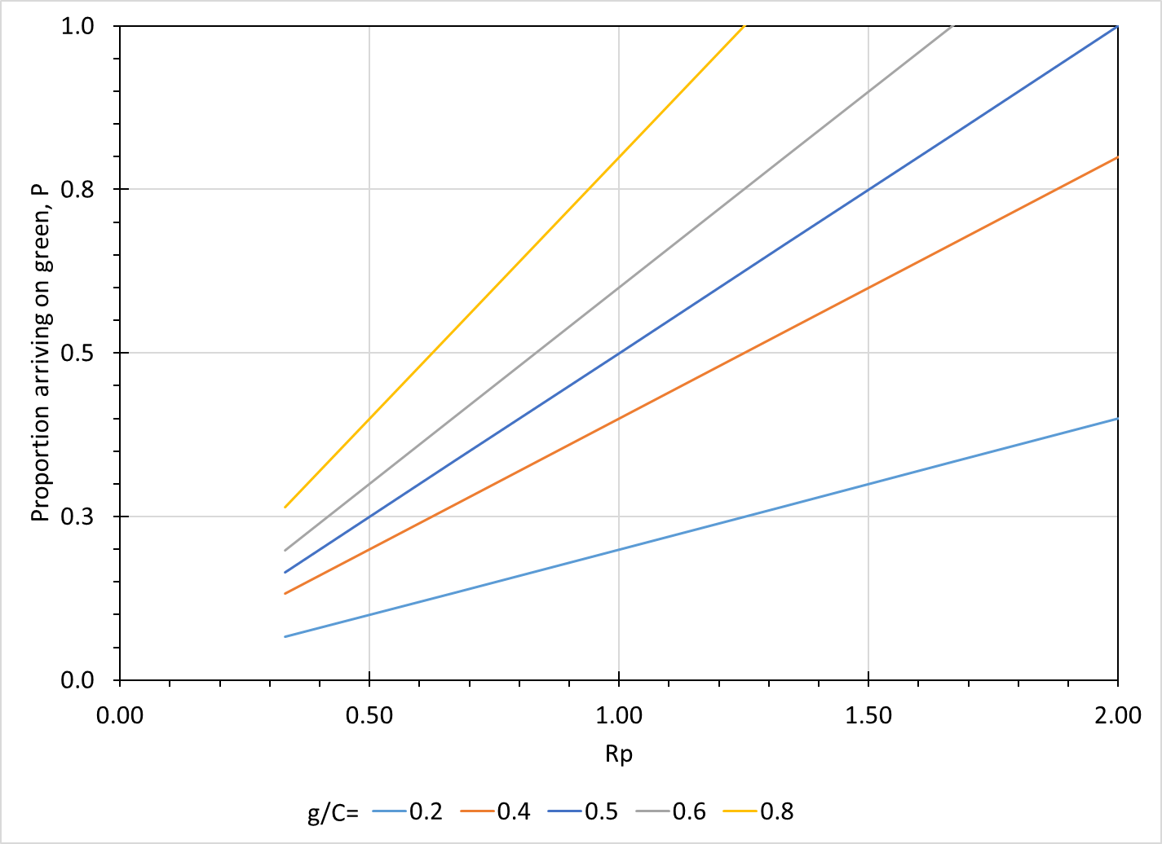
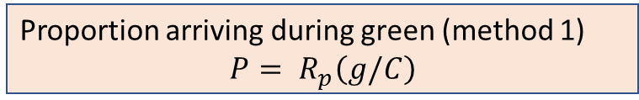
Concepts
Phase duration
Proportion arriving during green (method 1)
$$P= R_{p}\left(g/C\right)$$
HCM reference
p. 19-49
Data
Capacity
v/c ratio
Analysis Units
Delay
Flow rates
Level of service
Saturation flow rate
Queue storage ratio
Arrival pattern
Interpretation
HCM Signalized Intersection Methodology
Notes:
The fifth step of the HCM method

Slide 32
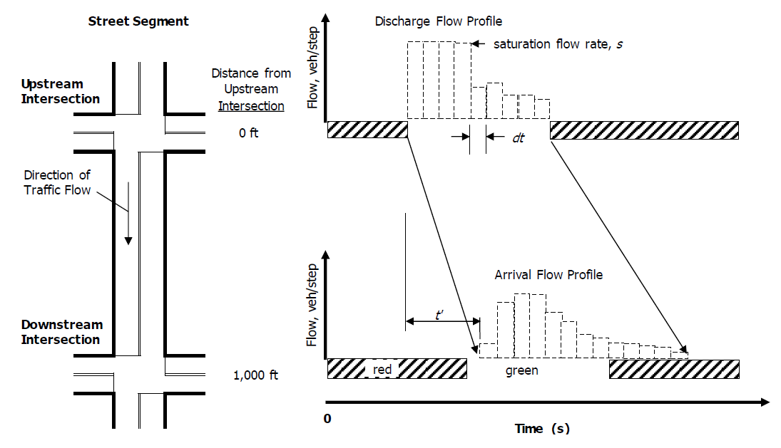
Concepts
Phase duration
Proportion arriving during green (method 2)
Discharge flow profile
Estimated arrival flow profile
HCM reference
pp. 30-7 to 30-8
pp. 30-8 to 30-10
Data
Capacity
v/c ratio
Analysis Units
Delay
Flow rates
Level of service
Saturation flow rate
Queue storage ratio
Arrival pattern
Interpretation
HCM Signalized Intersection Methodology

Slide 33
Delay
11. Non-uniform arrivals
Objective
Determine arrival flow profile diagram
Use resulting QAP to compute delay
Concepts
Offset
Chapter 4 – Capacity of Signalized Intersections

Slide 34
Delay
11. Non-uniform arrivals
Objective
Determine arrival flow profile diagram
Use resulting QAP to compute delay
Concepts
Departure flow profile
Arrival flow pattern
Chapter 4 – Capacity of Signalized Intersections

Slide 35

Delay
11. Non-uniform arrivals
Objective
Determine arrival flow profile diagram
Use resulting QAP to compute delay
Concepts
Departure flow profile
Arrival flow pattern
Predicted flow rate at downstream intersection
$$q_{d,i}=Fq_{u,i−t^{′}}+(1−F)q_{d,i−1}$$
Chapter 4 – Capacity of Signalized Intersections

Slide 36
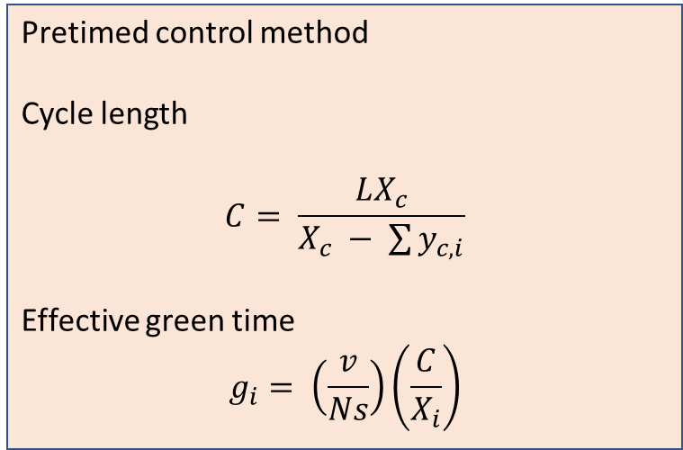
Concepts
Phase duration
Pretimed control method
Cycle length
$$C= \frac{LX_{c}}{X_{c} − \sum{y_{c,i}}}$$
Effective green time
$$g_{i}= \left(\frac{v}{Ns}\right)\left(\frac{C}{X_{i}}\right)$$
HCM reference
pp. 31-30 to 31-33
Data
Capacity
v/c ratio
Analysis Units
Delay
Flow rates
Level of service
Saturation flow rate
Queue storage ratio
Arrival pattern
Interpretation
HCM Signalized Intersection Methodology

Slide 37
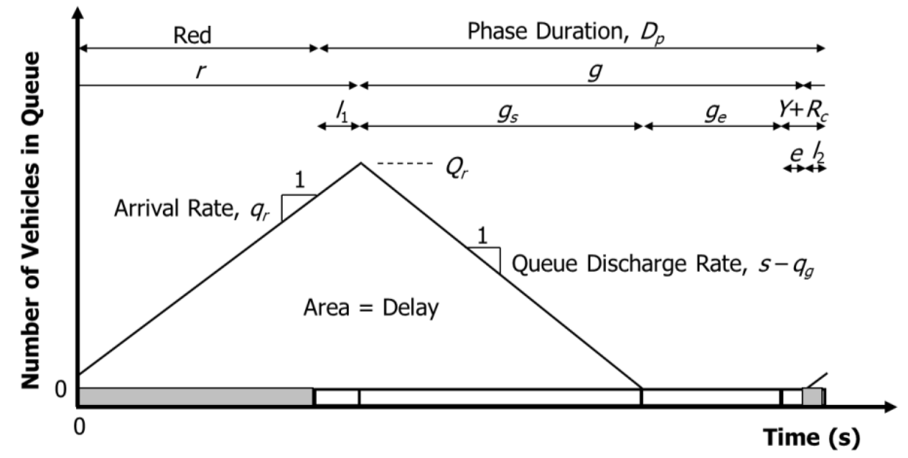
Concepts
Phase duration
Actuated control method
Concepts
Volume computations
Queue accumulation polygon
Maximum allowable headway
Equivalent maximum green
Average phase duration
Probability of max-out
HCM reference
pp. 31-2 to 31-22
Data
Capacity
v/c ratio
Analysis Units
Delay
Flow rates
Level of service
Saturation flow rate
Queue storage ratio
Arrival pattern
Interpretation
HCM Signalized Intersection Methodology

Slide 38
Phase duration
12. Phase duration
Objective
Determine phase duration
Concepts
Queue service time
Green extension time
  Maximum allowable headway
  Number of possible extensions
  Probability that headway is less than MAH
  Number of predicted extensions before phase termination
Chapter 4 – Capacity of Signalized Intersections

Slide 39
Phase duration
12. Phase duration
Objective
Determine phase duration
Concepts
Queue service time
Green extension time
  Maximum allowable headway
  Number of possible extensions
  Probability that headway is less than MAH
  Number of predicted extensions before phase termination
Chapter 4 – Capacity of Signalized Intersections

Slide 40
Phase duration
12. Phase duration
Objective
Determine phase duration
Concepts
Queue service time
Green extension time
  Maximum allowable headway
  Number of possible extensions
  Probability that headway is less than MAH
  Number of predicted extensions before phase termination
MAH
Chapter 4 – Capacity of Signalized Intersections

Slide 41
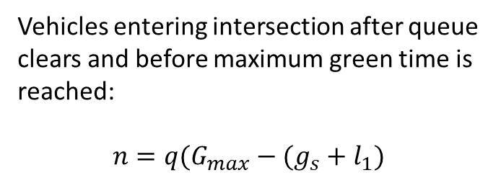
Phase duration
12. Phase duration
Objective
Determine phase duration
Concepts
Queue service time
Green extension time
  Maximum allowable headway
  Number of possible extensions
  Probability that headway is less than MAH
  Number of predicted extensions before phase termination
Possible green extension
Vehicles entering intersection after queue clears and before maximum green time is reached:
$$n=q(G_{max}−(g_{s}+l_{1})$$
Chapter 4 – Capacity of Signalized Intersections

Slide 42

Phase duration
12. Phase duration
Objective
Determine phase duration
Concepts
Queue service time
Green extension time
  Maximum allowable headway
  Number of possible extensions
  Probability that headway is less than MAH
  Number of predicted extensions before phase termination
Possible green extension
h
$$p\left[h≤MAH\right]=1 − φe^{−λ(MAH−Δ)}$$
Chapter 4 – Capacity of Signalized Intersections

Slide 43
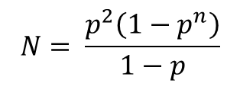
Phase duration
12. Phase duration
Objective
Determine phase duration
Concepts
Queue service time
Green extension time
  Maximum allowable headway
  Number of possible extensions
  Probability that headway is less than MAH
  Number of predicted extensions before phase termination
Predicted green extension
h
1
2
3
4
….
N
$$N= \frac{p^{2}\left(1−p^{n}\right)}{1−p}$$
Passage time
Chapter 4 – Capacity of Signalized Intersections

Slide 44
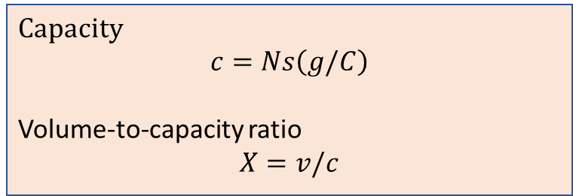
Concepts
Phase duration
Capacity
$$c=Ns\left(g/C\right)$$
Volume-to-capacity ratio
$$X=v/c$$
HCM reference
p. 19-50
Data
Capacity
v/c ratio
Analysis Units
Delay
Flow rates
Level of service
Saturation flow rate
Queue storage ratio
Arrival pattern
Interpretation
HCM Signalized Intersection Methodology

Slide 45
Capacity
6. Lane capacity
Add graphics from book?
Objective
Determine lane capacity
Concepts
Saturation flow rate
Green ratio
Chapter 4 – Capacity of Signalized Intersections

Slide 46
Capacity
8. Permitted LT movement
Objective
Determine LT lane capacity
Concepts
Permitted LT movement
Gap acceptance process
Chapter 4 – Capacity of Signalized Intersections

Slide 47
Capacity
9. Capacity utilization
Objective
Determine capacity utilization
Concepts
Critical movement analysis
Chapter 4 – Capacity of Signalized Intersections

Slide 48
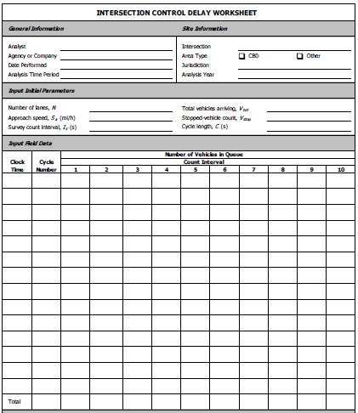
Concepts
Phase duration
Field measurement technique
HCM reference
pp. 31-99 to 31-105
Data
Capacity
v/c ratio
Analysis Units
Delay
Flow rates
Level of service
Saturation flow rate
Queue storage ratio
Arrival pattern
Interpretation
HCM Signalized Intersection Methodology

Slide 49
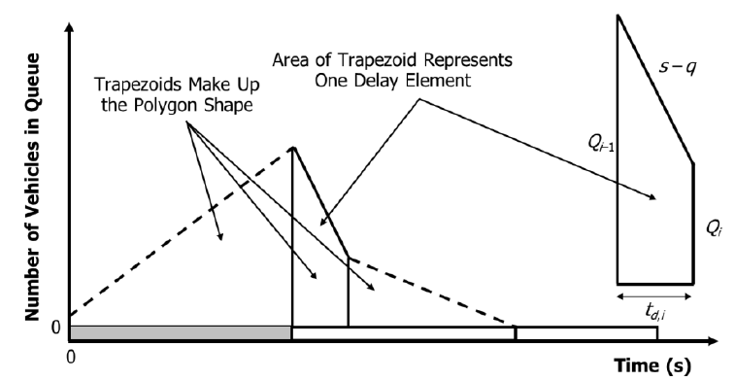
Concepts
Phase duration
Uniform delay
Queue accumulation polygon
HCM reference
p. 19-51
pp. 31-42 to 31-45
pp. 31-42 to 31-62*(add)
Data
Capacity
v/c ratio
Analysis Units
Delay
Flow rates
Level of service
Saturation flow rate
Queue storage ratio
Arrival pattern
Interpretation
HCM Signalized Intersection Methodology

Slide 50
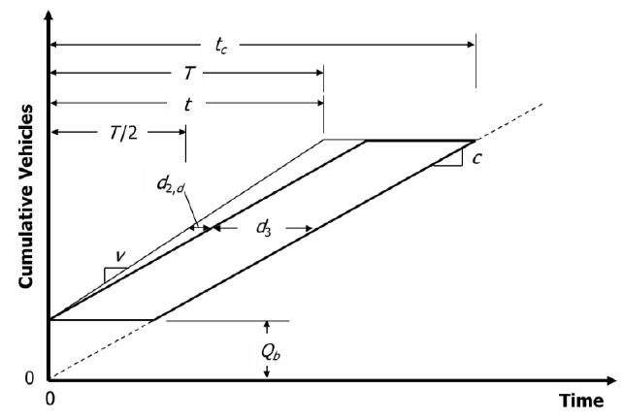
Concepts
Phase duration
Initial queue delay
HCM reference
p. 19-51
Data
Capacity
v/c ratio
Analysis Units
Delay
Flow rates
Level of service
Saturation flow rate
Queue storage ratio
Arrival pattern
Interpretation
HCM Signalized Intersection Methodology

Slide 51
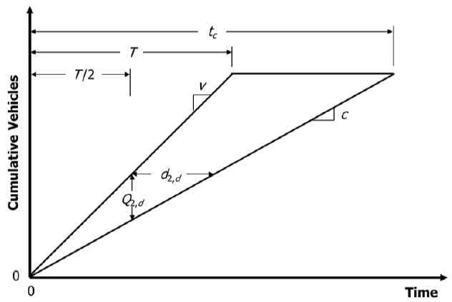
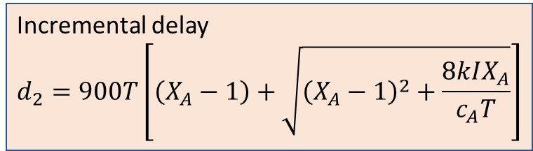
Concepts
Phase duration
Incremental delay
$$d_{2}=900T\left[\left(X_{A}−1\right)+\sqrt{{\left(X_{A}−1\right)}^{2}+\frac{8kIX_{A}}{c_{A}T}}\right]$$
HCM reference
pp. 19-51 to 19-53
Data
Capacity
v/c ratio
Analysis Units
Delay
Flow rates
Level of service
Saturation flow rate
Queue storage ratio
Arrival pattern
Interpretation
HCM Signalized Intersection Methodology

Slide 52
Delay
7. Calculating delay (D < C)
Objective
Determine delay when D < C
Concepts
Cumulative vehicle diagram
Queue accumulation polygon
Chapter 4 – Capacity of Signalized Intersections

Slide 53
Delay
10. Calculating delay (D > C)
Objective
Determine delay when D > C
Concepts
Flow profile diagram
Cumulative vehicle diagram
Queue accumulation polygon
Chapter 4 – Capacity of Signalized Intersections

Slide 54
Delay
10. Calculating delay (D > C)
Objective
Determine delay when D > C
Concepts
Flow profile diagram
Cumulative vehicle diagram
Queue accumulation polygon
Chapter 4 – Capacity of Signalized Intersections

Slide 55
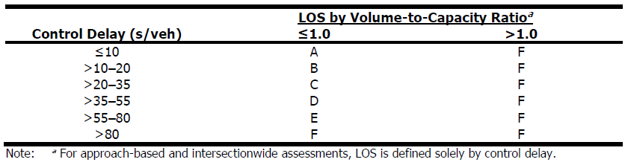
Concepts
Phase duration
Control delay and level of service
HCM reference
pp. 19-14 to 19-16
p. 19-54
Data
Capacity
v/c ratio
Analysis Units
Delay
Flow rates
Level of service
Saturation flow rate
Queue storage ratio
Arrival pattern
Interpretation
HCM Signalized Intersection Methodology

Slide 56
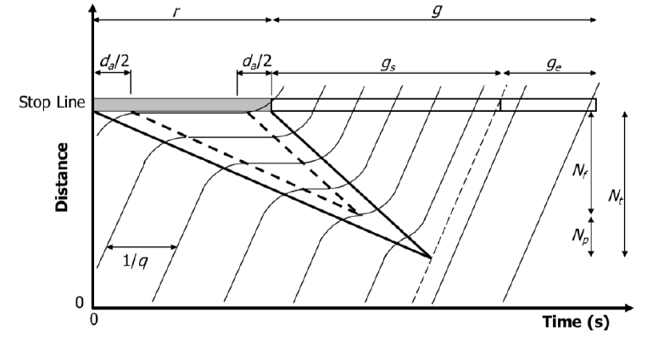
Concepts
Phase duration
Queue storage ratio
HCM reference
pp. 19-54 to 19-55
pp. 31-63 to 31-70
Data
Capacity
v/c ratio
Analysis Units
Delay
Flow rates
Level of service
Saturation flow rate
Queue storage ratio
Arrival pattern
Interpretation
HCM Signalized Intersection Methodology

Slide 57
Concepts
Phase duration
Interpretation of results
Level of service
Volume-to-capacity ratio
Volume-to-capacity ratio and delay combinations
HCM reference
pp. 19-55 to 19-57
Data
Capacity
v/c ratio
Analysis Units
Delay
Flow rates
Level of service
Saturation flow rate
Queue storage ratio
Arrival pattern
Interpretation
HCM Signalized Intersection Methodology

Slide 58
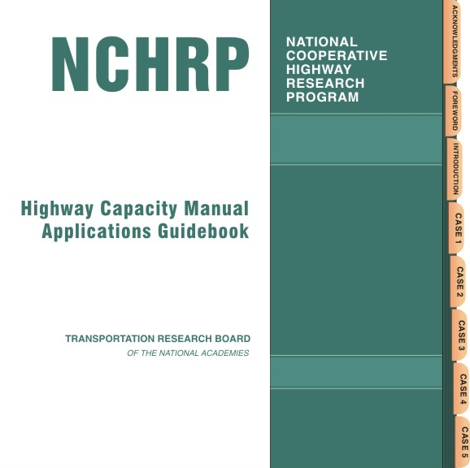
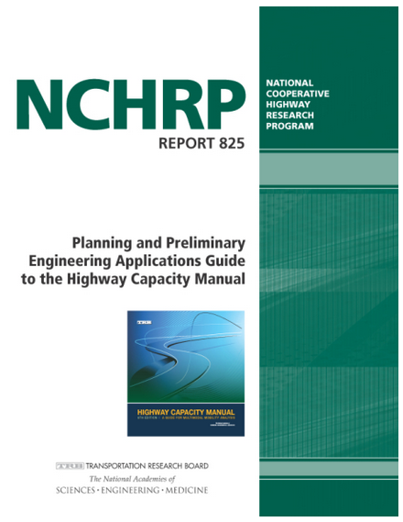

Slide 59
Highway Capacity Manual
6th Edition
Transportation Research Board
Traffic Operations at Intersections
Learning and Applying
the Models and Methods of the
Highway Capacity Manual
Using Simplified Scenarios and
Computational Engines
Michael Kyte and Rod Troutbeck
Notes:
Thanks for watching this presentation today. To find out more, here are some links that you might find helpful:
The book’s website.
A link to the Transportation Research Board website where you can purchase the HCM.
And a link to the website for the Committee on Highway Capacity and Quality of Service where you can find out more about the group that is responsible for developing and maintain the HCM. Thanks so much for watching this presentation. We wish you safe travels on your journey through the intersections the lie ahead.

