Slide 1
HCM Signalized Intersection Method Chapter 19 - Prototype
Signalized Intersection Subcommittee Meeting
January 2016

Slide 2
Purpose of today’s discussion
Review principles, propositions, and prototypes for new signalized intersection materials

Slide 3
The past year…
TRB 2015 SigSub | “Some Recommendations For Chapters 19 And 31 – Signalized Intersection Methodologies”, 26 December 2014
April 2015 | Working group conference call
June 2015 | SigSub summer meeting discussion
Paper for TRB 2016 | “The Signalized Intersection Method of the Highway Capacity Manual: A State of Crisis”
TRB 2016 SigSub | “Chapter 19 Signalized Intersections – Prototype Chapter”

Slide 4
“The Signalized Intersection Method of the Highway Capacity Manual: A State of Crisis”
What we believe to be true
Growing friction between increased complexity of method and ability of users to understand method
Fewer committee members have time to understand full details and implications of method
HCM signals method is only one of a number of methods available today
Evolution of method has been piecemeal, not systematic
Few instances of validation
Software must be used to apply method

Slide 5
“The Signalized Intersection Method of the Highway Capacity Manual: A State of Crisis”
Idea #1. More clearly identify user groups of the HCM and their needs
Largest group is practitioners. They will almost always use software application. They need to understand basic concepts, know what data are needed, and know how to interpret results
Researchers and teachers need access to computational details of method so they can test them, extend them, and teach them
Software developers need complete description of method so that they can write software applications.

Slide 6
“The Signalized Intersection Method of the Highway Capacity Manual: A State of Crisis”
Idea #2. Present the method around the needs of each group of users
Chapter 19 for practitioners; chapter 31 for others
Use roadmaps to guide users
Provide more example applications
Provide concepts needed to understand method
Provide guidance on when to apply method and what data are needed

Slide 7
“The Signalized Intersection Method of the Highway Capacity Manual: A State of Crisis”
Idea #3. Conduct systematic assessment of existing method
Determine value added by each factor and sub-model
Validate the method
Integrate existing high resolution data sources into method

Slide 8
Chapter 19: Signalized Intersections – Prototype
Principles
Practitioners use software applications; HCM needs to prepare them for experience of using software
HCM needs to consider user experience; roadmaps help to let user know where to go to accomplish task
For basic method: integrate explanations into worksheets
For advanced method: prepare user for software use; don’t provide more information than is needed
Provide information at points that it is needed even if same information is repeated in several places

Slide 9
Chapter 19: Signalized Intersections – Prototype
Principles
Chapter 19 provides information for practitioners … and only information needed to apply basic method or advanced method
Chapter 31 provides information for researchers, teachers, and software developers

Slide 10
Chapter 19: Signalized Intersections – Prototype
What prototype is…and what it isn’t
Intended to show what a different approach could look like…
Not intended to resolve all details at this point

Slide 11
Chapter 19
Focus:
Practitioners
1. Introduction
2. Traffic Flow and Signal Control
Concepts
3. The Basic Method
4. Example Calculations for Basic Method
5. Guidance for Advanced Method

Slide 12
Element | Basic Method | Advanced Method
Method is appropriate when…
Method helps analyst to…
Method should not be applied when…
Method is applied using…
The method predicts…
The method…
Data required when applying method are provided in…
[See pages 1 and 2 in “Chapter 19 Signalized Intersections – Prototype Chapter”]

Slide 13
If you want to… | Go to page…
Understand traffic flow and signal control concepts that are the foundations of the basic and advanced methods…
Learn about and apply the basic method…
Learn about the advanced method…
[See page 3 in “Chapter 19 Signalized Intersections – Prototype Chapter”]

Slide 14
Traffic Flow and Signal Control Concepts
Representing traffic flow
Representing signal control
Capacity
Delay
[See page 4 in “Chapter 19 Signalized Intersections – Prototype Chapter”]

Slide 15
The Basic Method: Steps
Gather required data and/or accept suggested default values
Identify desired LT operation, or determine LT operation using checks
Convert movement volumes to through passenger car equivalents based on equivalency factors
Determine critical lane groups by calculating which sequence of phases requires maximum amount of green time based on volumes of movements they serve
Assess whether capacity of intersection is sufficient
Determine capacity and volume/capacity ratio
Determine delay and level of service
[See pages 5-18 in “Chapter 19 Signalized Intersections – Prototype Chapter”]

Slide 16
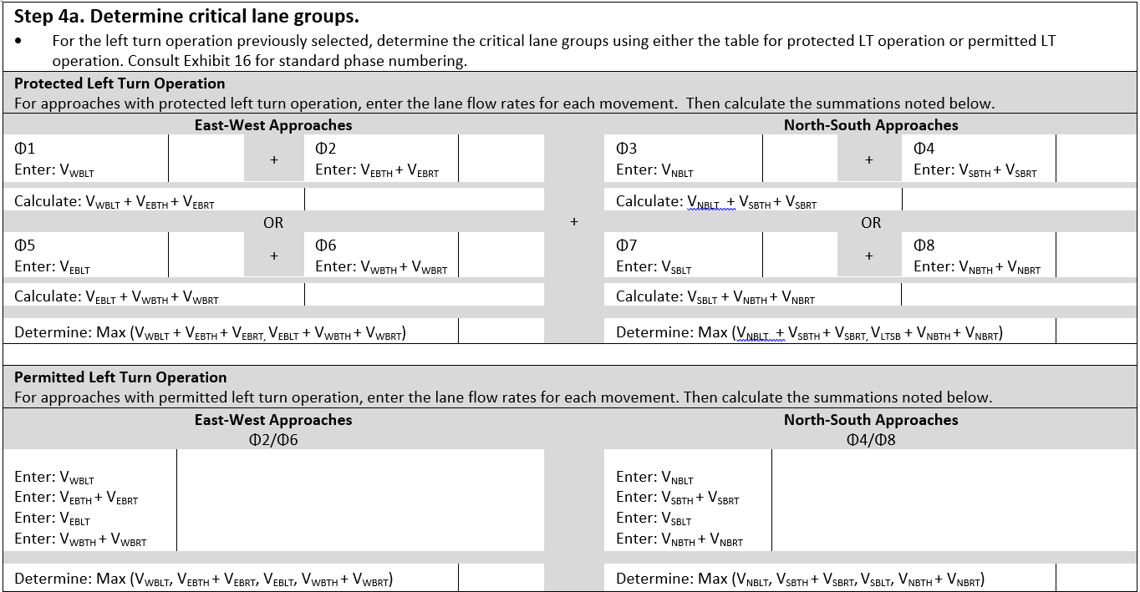
The Basic Method: Worksheets
[See pages 5-18 in “Chapter 19 Signalized Intersections – Prototype Chapter”]

Slide 17
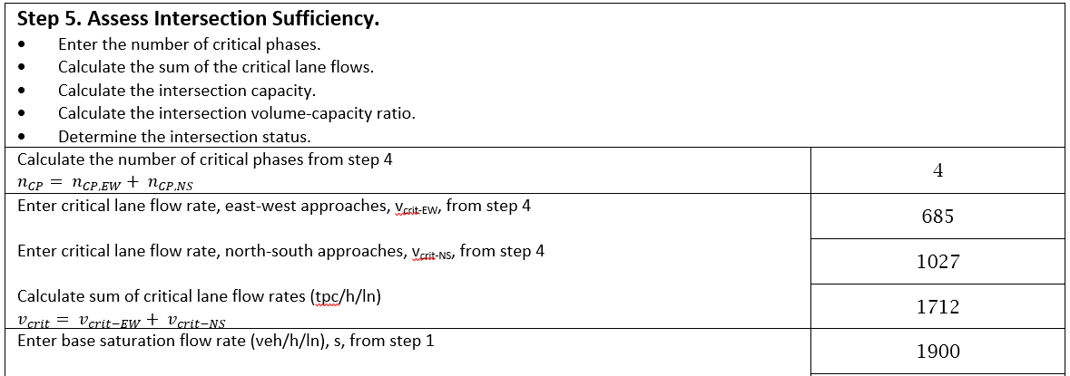
The Basic Method: Example Calculations
[See pages 19-31 in “Chapter 19 Signalized Intersections – Prototype Chapter”]

Slide 18
The Advanced Method
Proposition:
Specify the method as completely as possible but with the understanding that software developers will implement the method based on their own interpretation of the method and their own professional judgement
Overview
Data requirements
Method limitations/guidance to use simulation
Details in Chapter 31
[See pages 32-35 in “Chapter 19 Signalized Intersections – Prototype Chapter”]

Slide 19
Next steps…
Agreement: sense of prototype and direction
Proceed on three steps over 3-5 years for Chapter 19
Refine basic method
Develop text for traffic flow and signal control concepts
Develop ideas and text for advanced method
Proceed in 6-month increments with targets for annual and summer meetings

